Slide 1

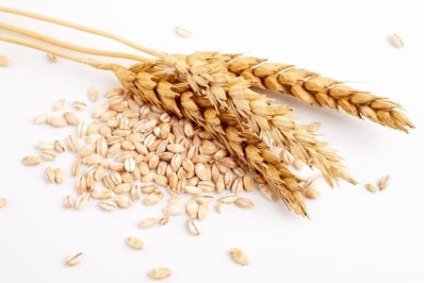
Sinhgad Institute of
Management,Vadgaon(Budruk),Pune
Project Name: GrainsMart
Presented by: Shubham Giramkar
Roll No:22318
Under Guidance:Dr.Milind Godase

Slide 2
INTRODUCTION
The ”GrainsMart” has been developed for provide platform for farmers to sell their grains directly to customer.
Customer can order grains directly from farmers.
This Software allows to customers for buy a grains from their regular seller as well as new seller farmer.
It also allows for customer to order grains in best price from farmers.
This System is designed for to simplify market process.

Slide 3

EXISTING SYSTEM
The Existing system is manual and offline system.
The customers and farmers are goes to the market and sells and orders the grains.
The complete process depends on the physical interaction.

Slide 4
SYSTEM REQUIREMENT
Hardware Requirements:
PROCESSOR: AMD RYZEN 3
RAM: 1GB+ DDR
HDD: 40GB
Software Requirements:
OPERATING SYSTEM: Windows/MacOS/Linux
WEB BROWSER: Mozilla Firefox, Google Chrome etc.

Slide 5
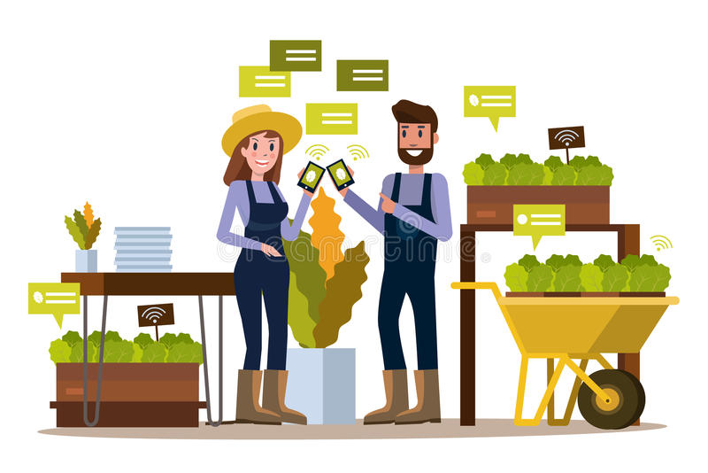
OBJECTIVES
The main objective of this project is to make a platform for farmers to sell their grains in digital market.
To make a website for customers for order grains directly from farmers.
The Purpose of the project is to build an website to reduce the manual and offline work.

Slide 6
SCOPE
This application is built in such way that it should suits for all types of customers and farmers in future.
The GrainsMart provides garin prices directly from farmers to order garins so customer can order different qualities of grains with proper cost.

Slide 7
TECHNOLOGY DETAILS
Front End:
Html
CSS
Javascript
Sever Side Language:
jsp and servlet.
Database:
MySQL

Slide 8
MODULES
Farmer Module:
1.Farmers Login/Register
2. Sell Grains
3.Update Stock and price module
4.Customers History Module
5.Transactions Module
6.Profile Module
Customer Module:
1.Customer Login/Register
2.Select Grains
3.select Farmer
Order Module:
1.Generate Bill
2.Cancel Order
3.History Module
Payment and Delivery Module

Slide 9
UML DIAGRAMS

Slide 10
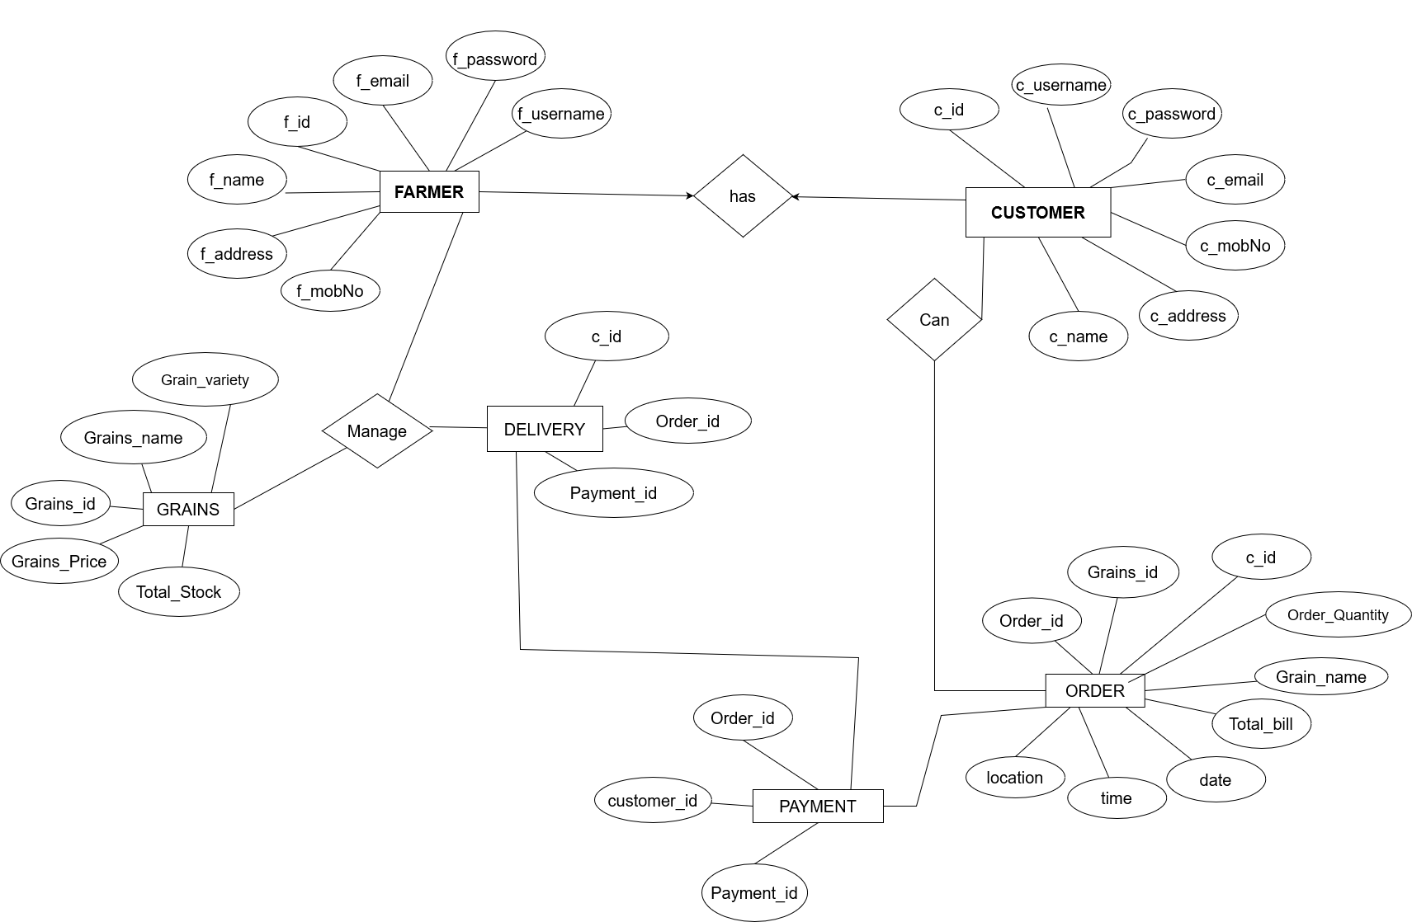
Entity Relationship Diagram (ERD):

Slide 11
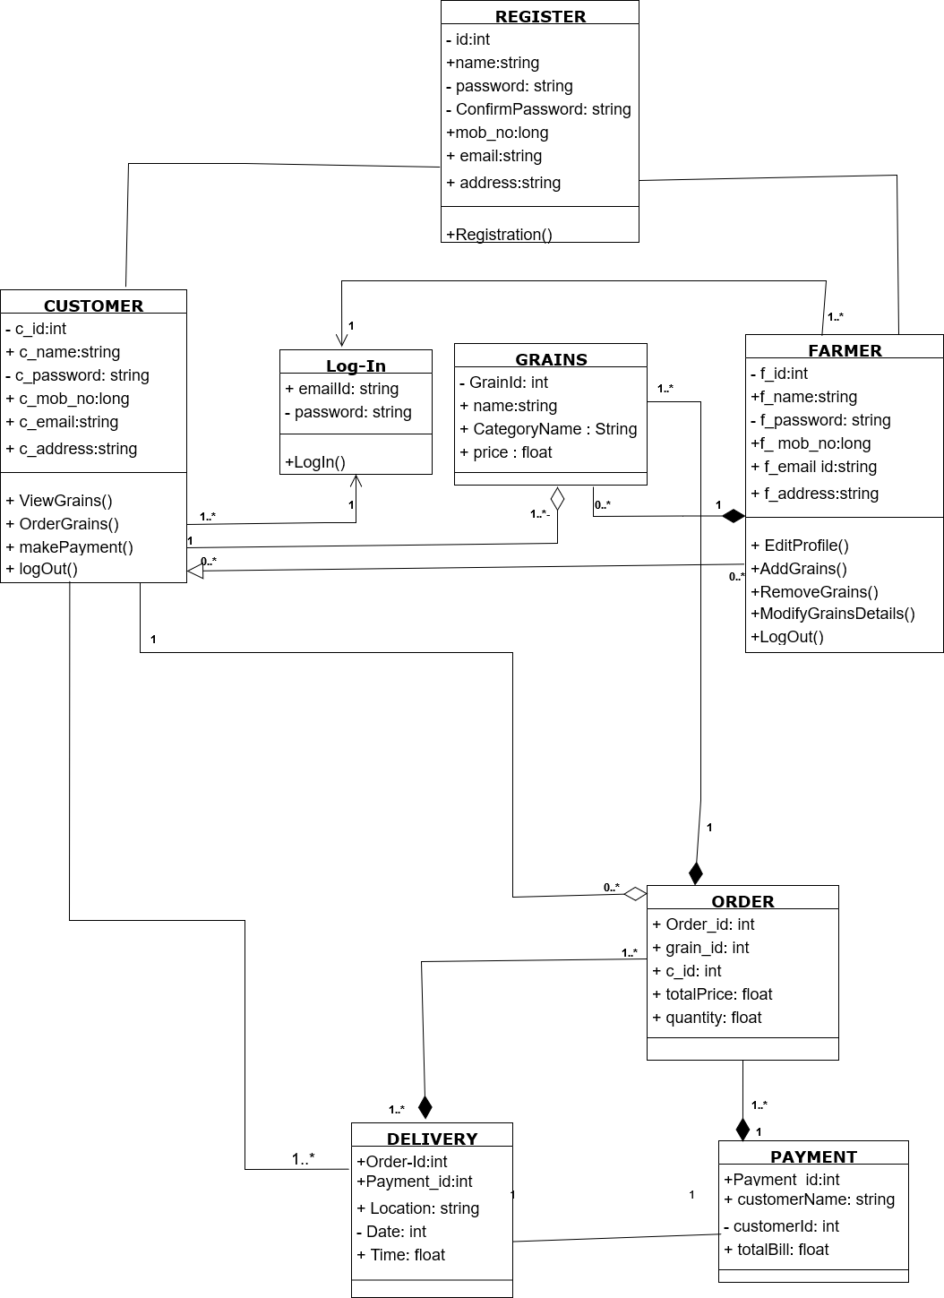
Class Diagram:

Slide 12
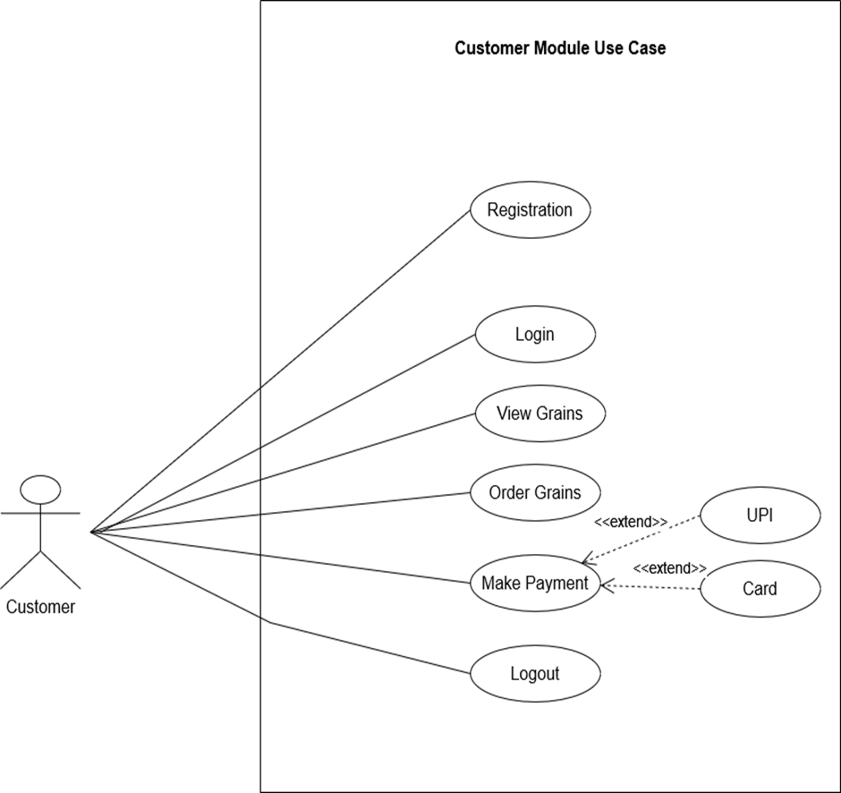
Use Case Diagrams:
USE CASE DIAGRAM FOR CUSTOMER

Slide 13
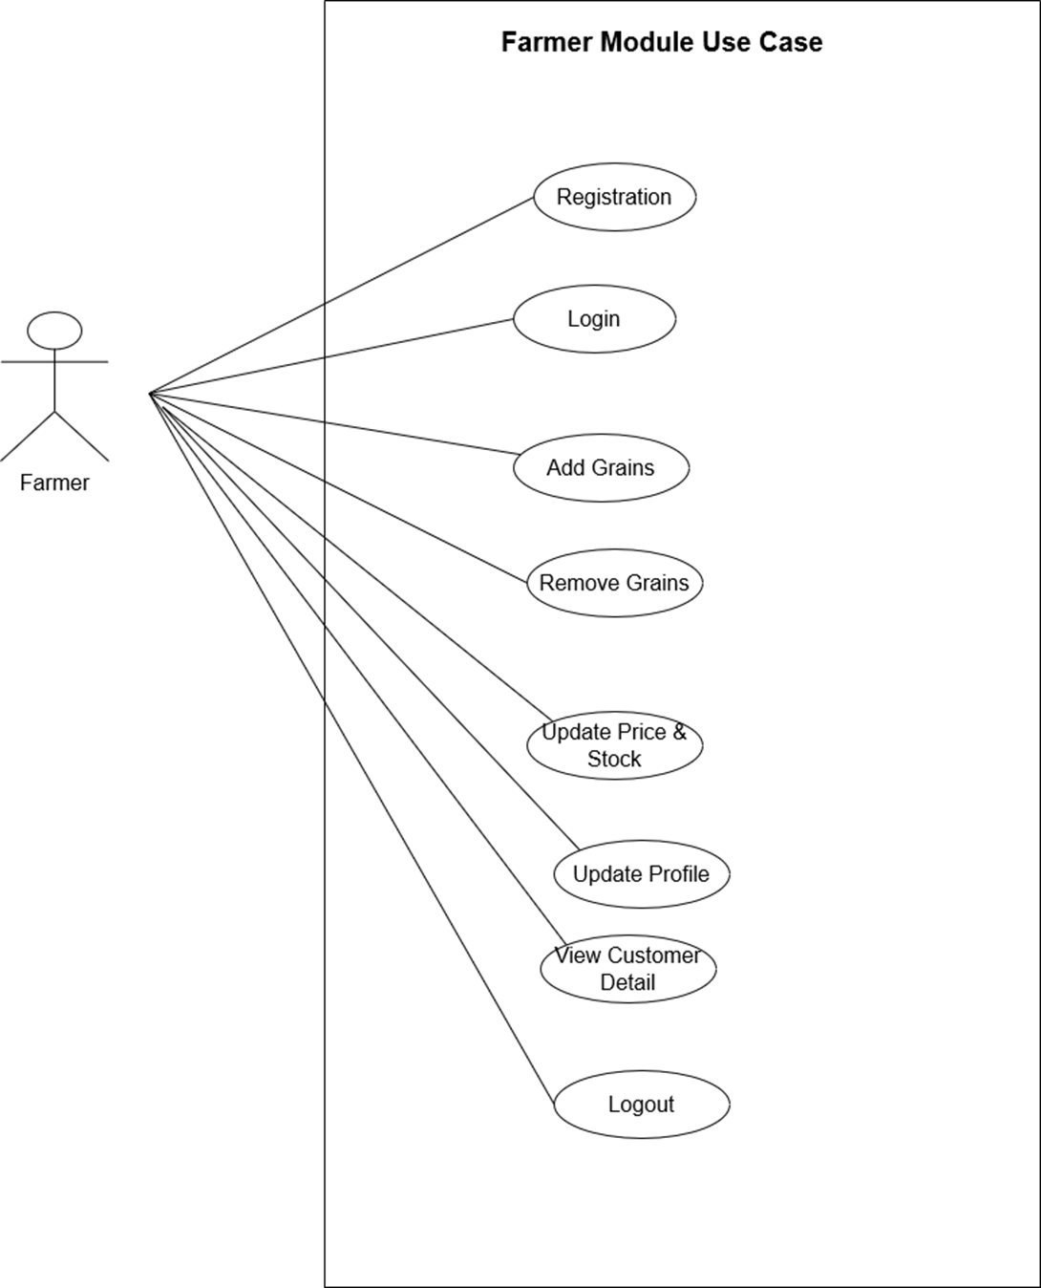
USE CASE DIAGRAM FOR FARMER

Slide 14
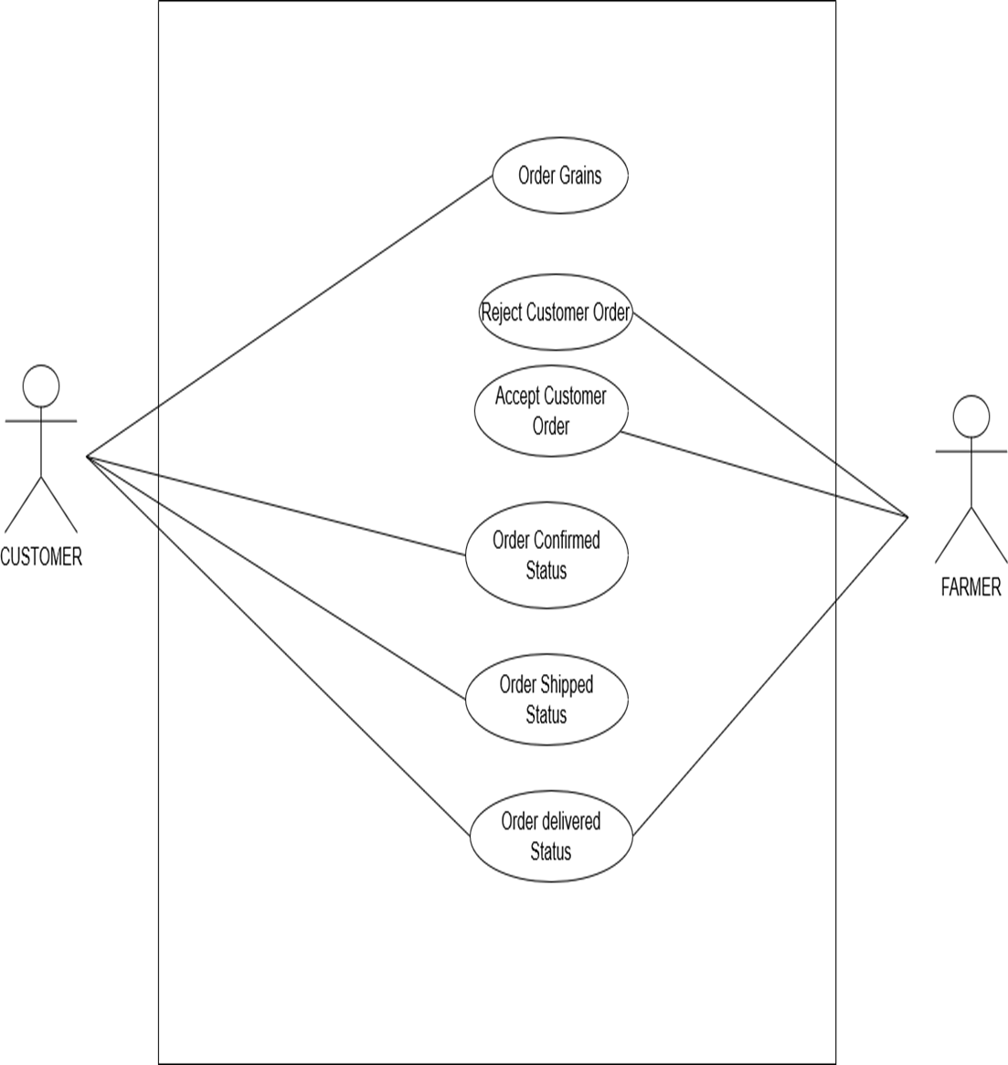
USE CASE DIAGRAM FOR ORDER

Slide 15
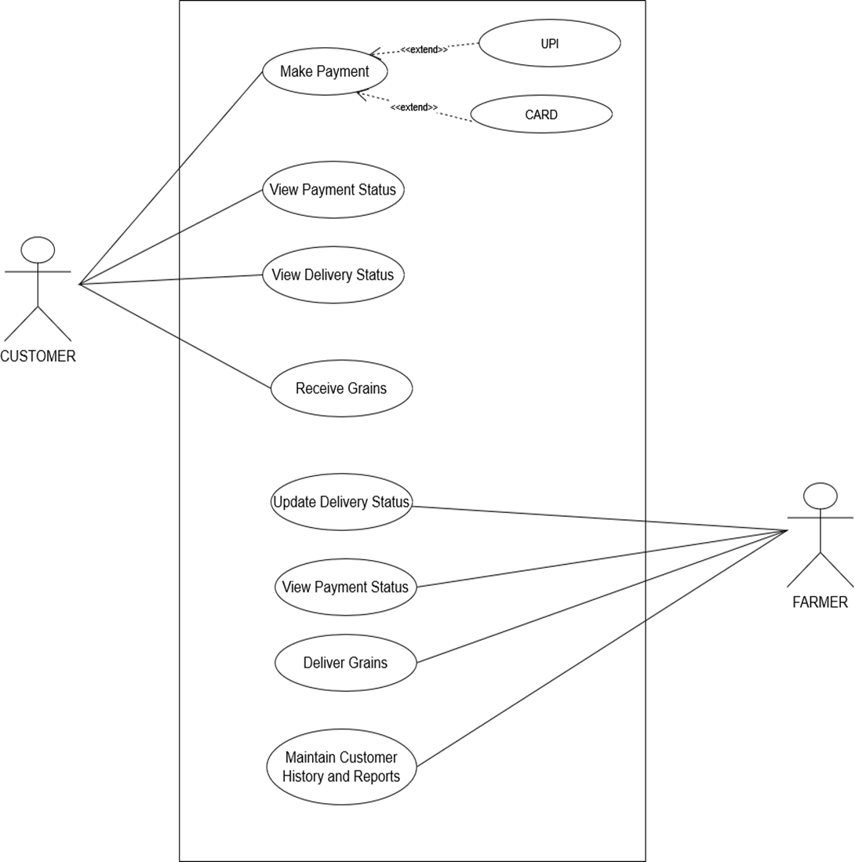
USE CASE DIAGRAM FOR PAYMENT AND DELIVERY

Slide 16
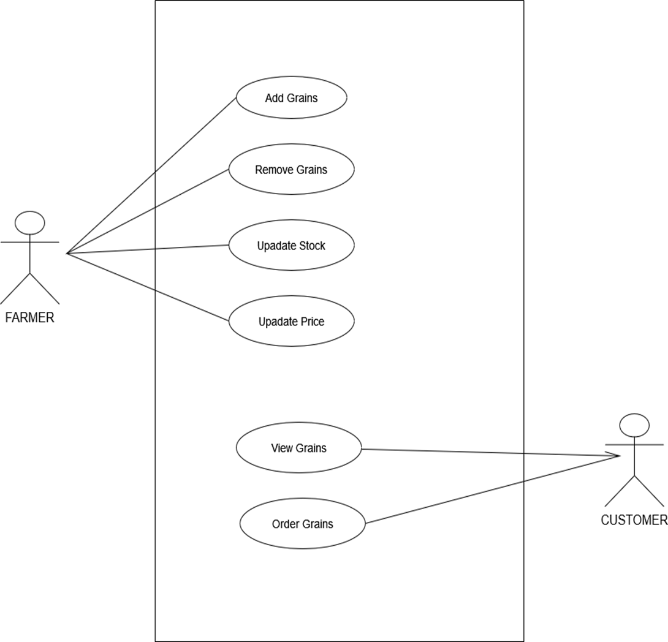
USE CASE DIAGRAM FOR GRAINS

Slide 17
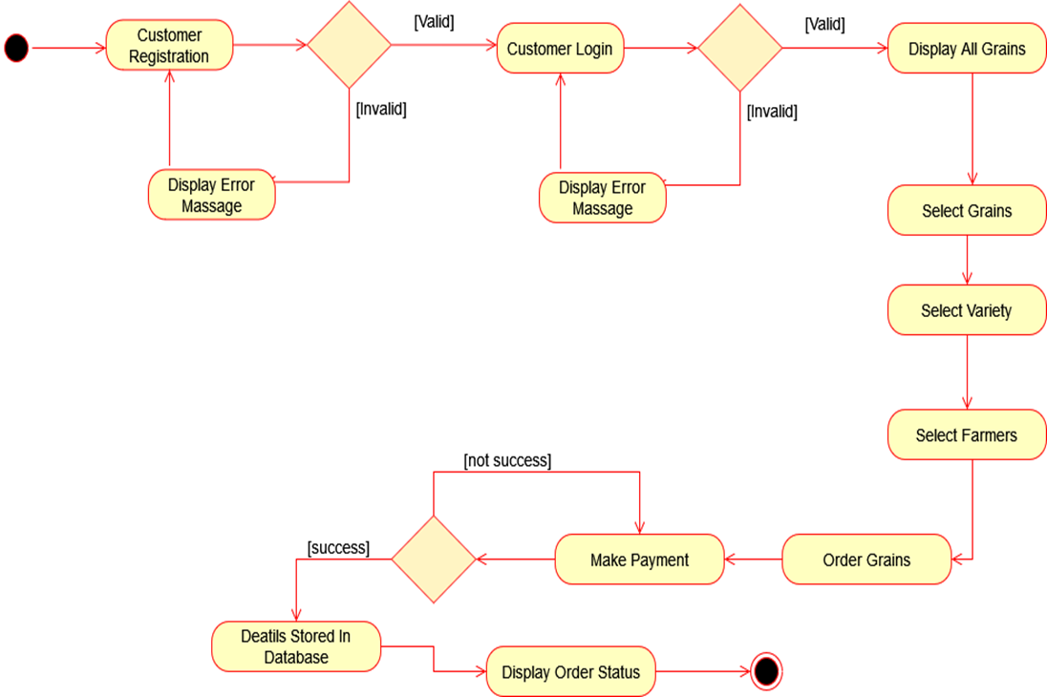
ACTIVITY DIAGRAM FOR CUSTOMER
Activity Diagram:

Slide 18
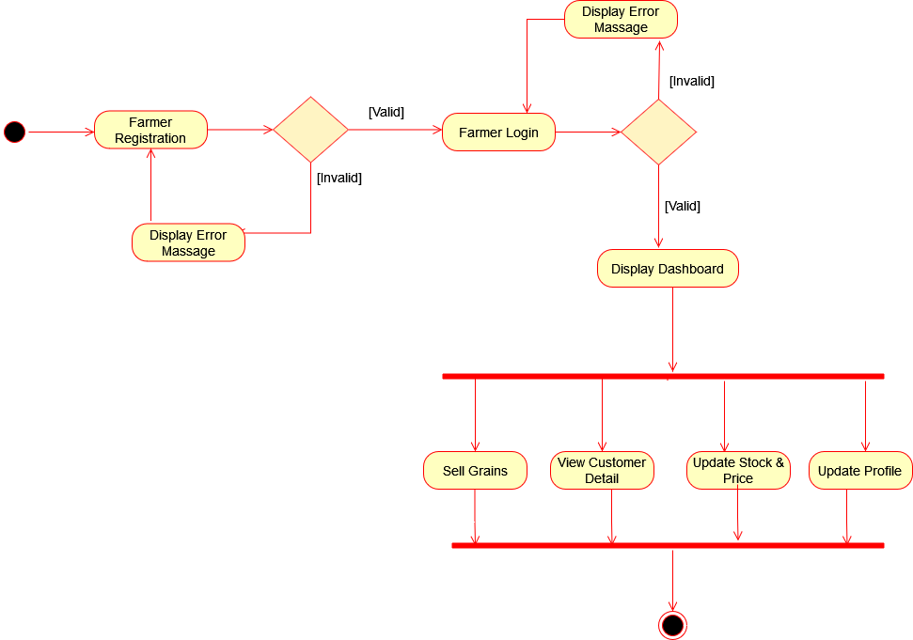
ACTIVITY DIAGRAM FOR FARMER

Slide 19
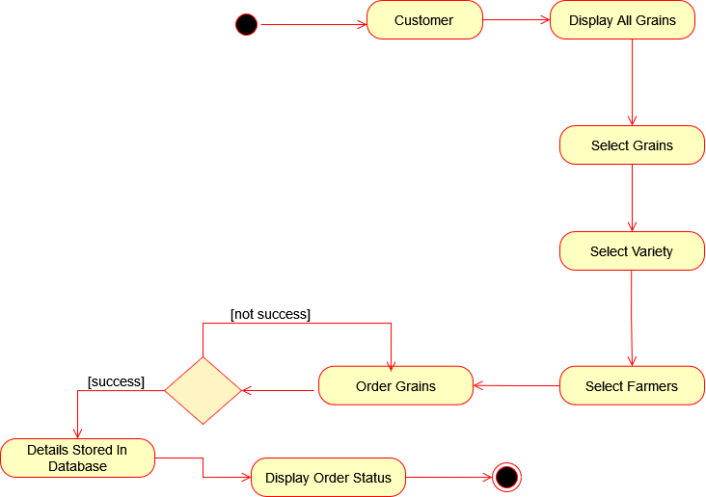
ACTIVITY DIAGRAM FOR ORDER

Slide 20
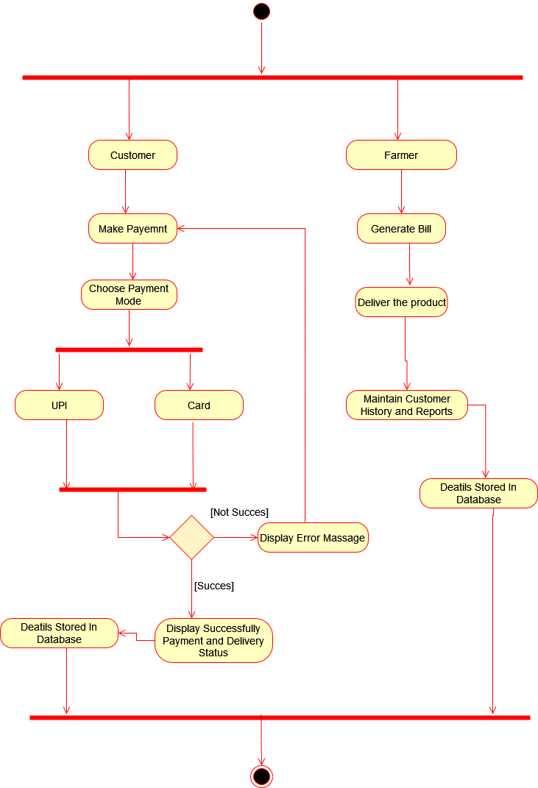
ACTIVITY DIAGRAM FOR PAYMENT AND DELIVERY

Slide 21
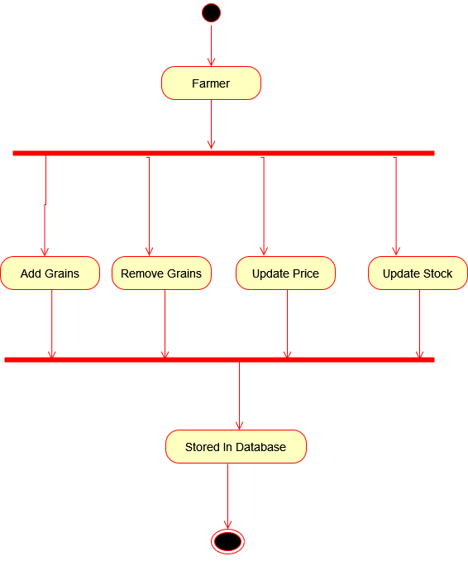
ACTIVITY DIAGRAM FOR GRAINS

Slide 22
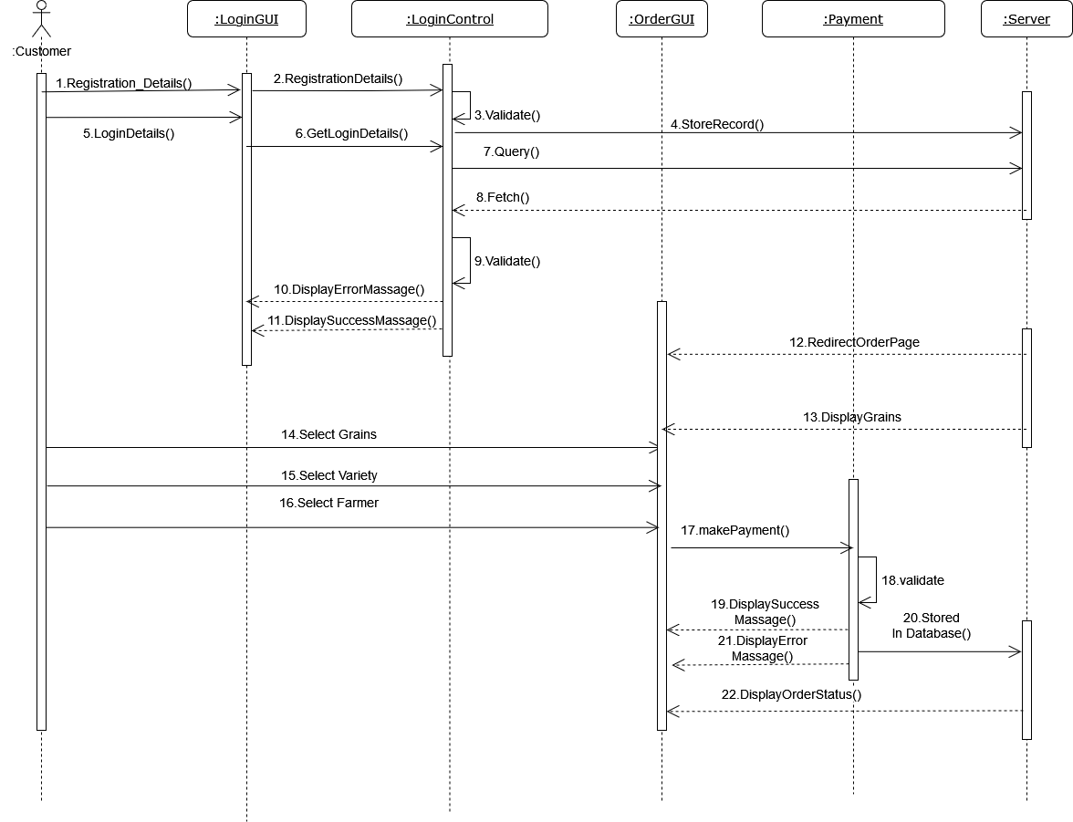
Sequence Diagram:
SEQUENCE DIAGRAM OF CUSTOMER

Slide 23
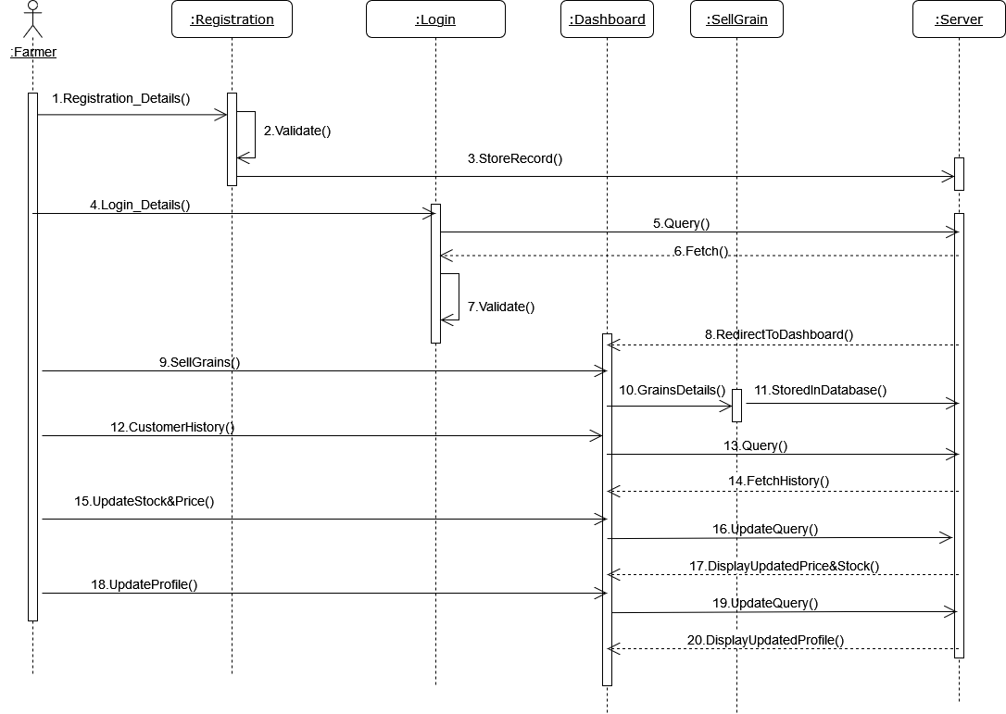
SEQUENCE DIAGRAM OF FARMER

Slide 24
SEQUENCE DIAGRAM OF ORDER

Slide 25
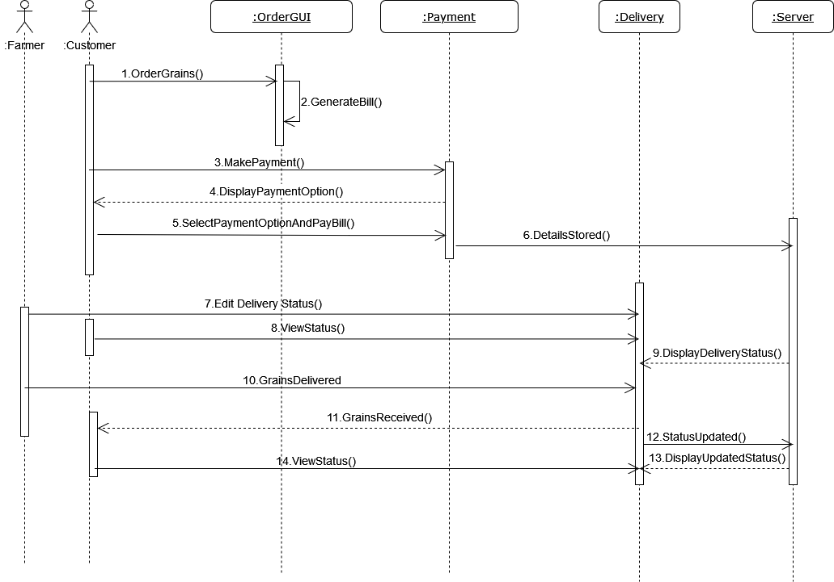
SEQUENCE DIAGRAM FOR PAYMENT AND DELIVERY

Slide 26
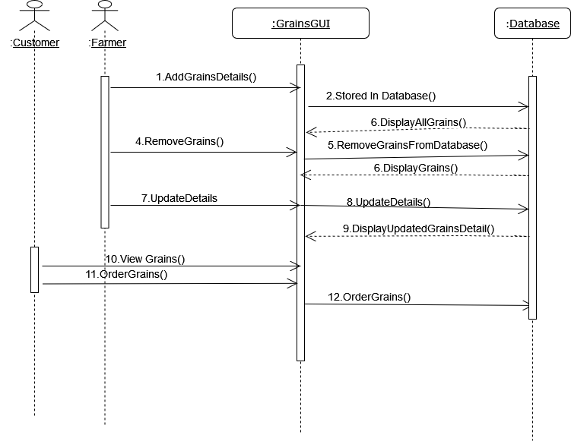
SEQUENCE DIAGRAM FOR GRAINS

Slide 27
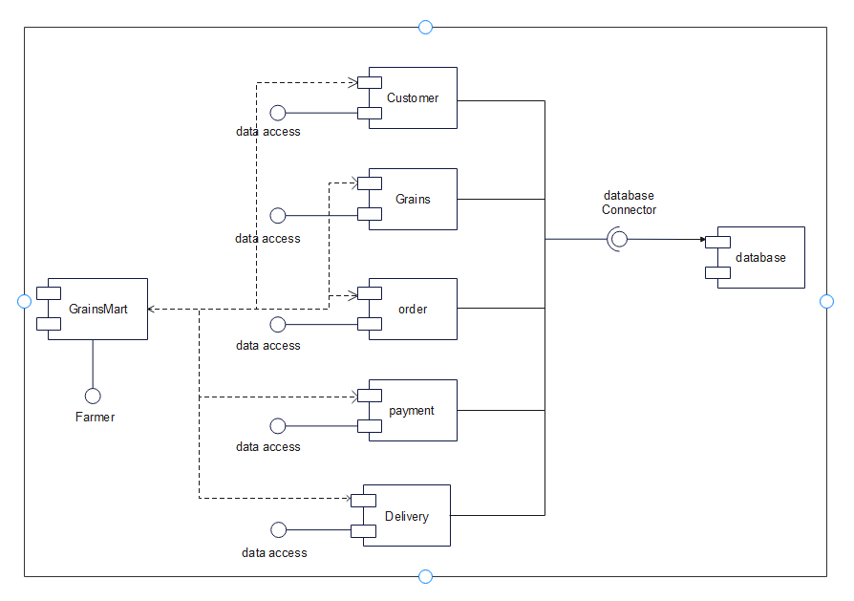
Component Diagram

Slide 28
Table Design
Field name | Datatype | Size | Constraints
f_id | int | 10 | Primary key
f_username | varchar | 10 | Not null
f_password | varchar | 12 | Not null
f_Name | varchar | 10 | Not null
f_email | varchar | 20 | Not null
f_MobileNo | int | 10 | Not null
f_Address | varchar | 20 | Not null
TABLE NAME: Customer
TABLE NAME: Farmer
Field name | Datatype | Size | Constraints
C_id | int | 10 | Primary key
C_username | varchar | 10 | Not null
C_password | varchar | 12 | Not null
C_Name | varchar | 10 | Not null
C_email | varchar | 20 | Not null
C_MobileNo | int | 10 | Not null
C_Address | varchar | 20 | Not null

Slide 29
TABLE NAME: Orders
Field name | Datatype | Size | Constraints
Order_id | int | 10 | Primary Key
Grains_id | int | 10 | Foreign key
C_id | int | 10 | Foreign Key
F_id | int | 10 | Foreign key
Order_quantity | int | 5 | Not null
Total_bill | int | 10 | Not null
Order_Date_time | date | -- | Not null
Delivery_address | varchar | 20 | Not null

Slide 30
TABLE NAME: Grains
Field name | Datatype | Size | Constraints
Grain_id | int | 10 | Primary key
Grain_Name | varchar | 20 | Not null
Grain_Variety | varchar | 20 | Not null
Grain_price | int | 10 | Not null
Total_Stock | int | 10 | Not null
TABLE NAME: Payments
Field name | Datatype | Size | Constraints
Payment_id | int | 10 | Primary key
Order_id | int | 10 | Foreign key
C_id | int | 10 | Foreign key

Slide 31
Data Dictionary
Field name | Datatype | Size | Constraints | Description | Table Name
f_id | int | 10 | Primary key | Represent Farmer Id | Farmer,Orders
f_username | varchar | 10 | Not null | Represent Farmer Username | Farmer
f_password | varchar | 12 | Not null | Represent Farmer login password | Farmer
f_Name | varchar | 10 | Not null | Represent Farmer name | Farmer
f_email | varchar | 20 | Not null | Represent Farmer email | Farmer
f_MobileNo | int | 10 | Not null | Represent Farmer MobileNo | Farmer
f_Address | varchar | 20 | Not null | Represent Farmer Address | Farmer
C_id | int | 10 | Primary key | Represent Customer Id | Customer,Orders,Payments
C_username | varchar | 10 | Not null | Represent Customer Username | Customer
C_password | varchar | 12 | Not null | Represent Customer password | Customer
C_Name | varchar | 10 | Not null | Represent Customer name | Customer
C_email | varchar | 20 | Not null | Represent Customer email | Customer
C_MobileNo | int | 10 | Not null | Represent Customer MobileNo | Customer
C_Address | varchar | 20 | Not null | Represent Customer Address | Customer

Slide 32
Order_id | int | 10 | Primary Key | Represent Order Id | Orders,Payments
Order_quantity | int | 5 | Not null | Represent Order Quantity | Orders
Total_bill | int | 10 | Not null | Represent Total Bill | Orders
Order_Date_time | date | -- | Not null | Represent Order Date&Time | Orders
Delivery_address | varchar | 20 | Not null | Represent Delivery Address | Orders
Grain_id | int | 10 | Primary key | Represent Grain id | Grains,Orders
Grain_Name | varchar | 20 | Not null | Represent Grain Name | Grains
Grain_Variety | varchar | 20 | Not null | Represent Grain Variety | Grains
Grain_price | int | 10 | Not null | Represent Grain price | Grains
Total_Stock | int | 10 | Not null | Represent Total Stock | Grains
Payment_id | int | 10 | Primary key | Represent Payment Id | Payments

Slide 33
Thank You

